Slide 1

A NEURAL NEWORK FROM SCRATCH USING Q-TIP
Sean Kennedy, SMU

Slide 2
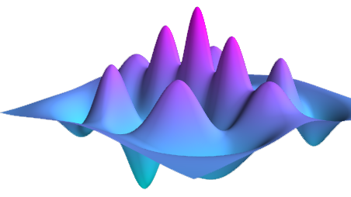

Qutip: Quantum toolbox in python
From the classroom to the corporate office, QuTiP is used around the world to advance research in quantum optics. QuTiP is in use at nearly every single research university around the globe, government-funded research labs, and is relied upon by every major corporation focused on developing a quantum computer.

Slide 3
What is Qutip?
“QuTiP is open-source software for simulating the dynamics of closed and open quantum systems. The QuTiP library uses the excellent Numpy, Scipy, and Cython packages as numerical backend, and graphical output is provided by Matplotlib. QuTiP aims to provide user-friendly and efficient numerical simulations of a wide variety of quantum mechanical problems, including those with Hamiltonians and/or collapse operators with arbitrary time-dependence, commonly found in a wide range of physics applications. QuTiP is freely available for use and/or modification, and it can be used on all Unix-based platforms and on Windows. Being free of any licensing fees, QuTiP is ideal for exploring quantum mechanics in research as well as in the classroom.” (https://github.com/qutip/qutip/blob/master/README.md)
Notes:
Part of the NUMFOCUS project (scipy, numpy, sympy) – QuTiP is an open source library used throughout academia and enterprise and is designed specifically for the purpose of developing a quantum computer.
Native latex support makes it ideal for scientific literature and it’s interface is immediately intuitive to anyone familiar with the matrix formulation of QM.

Slide 4
WhY do SMART PEOPLE physicists like it?
Two Words – Bra-Ket Notation (perhaps there’s more to it than that, but this is a good place to start).
LaTex – not the freaky kind (which is fun) , the text kind – which is beautiful in its own right.
Plotting – Who wants to make all those nasty 3-d plots that optics is famous for? Let an API do that for you. Stand on the shoulders of giants (especially when it comes to matplotlib which serves as the main plotting engine).
Tensors* – Get crazy and rebuild tensorflow from scratch? We’ll do just that in this analysis (well, perhaps a reasonable facsimile given the time constraint, but neural nets are all black box anyway – as long is works – amirite????). Google, watch your back.
* No real tensors will be used in this process, that would be crazy – BUT – we could if we wanted to….

Slide 5
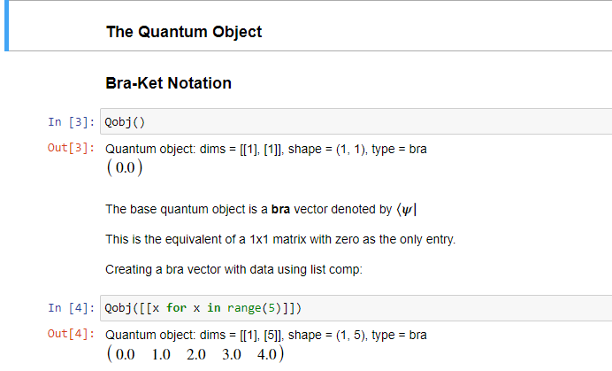
BRA-KET Notation: Why aren’t you using this?
Introduced by physics legend Paul Dirac, bra-ket notation is method for expressing linear algebra concepts concisely – independent of the number of basis vectors chosen to represent the underlying system.
Of interest, is the ease with which bra-ket notation makes the mathematical concept of the inner/dot product between two vectors simple to represent.
In the QuTiP nomenclature, all objects inherit from the base QuantumObject (Qobj)
This object is a “bra” or, more concisely, a row vector
Notes:
Think of a Bra as a row vector
Inner product – defines the inner product space
The inner product provides the definition of distance
Also defines the concept of angle

Slide 6
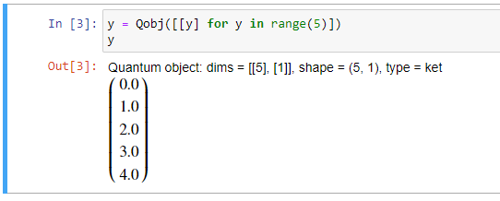
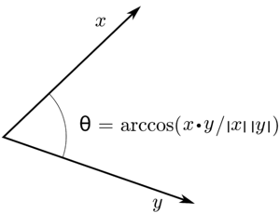
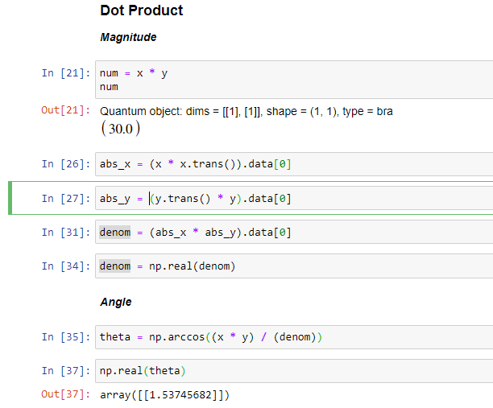

Kets and the inner product
This object is a “ket” or, more concisely, a column vector
Note the extra brackets around our initialization variable, y. This instructs the QuTip API to create a column vector rather than a row vector.
A vector space is considered an inner product space if there exists a function that defines both the distance and orientation between two different vectors in the space.
In 2-d space, the inner product can be represented in terms of the lengths of vectors x and y and the cosine of the angle between them.
Notes:
Think of a Ket as a column vector
Inner product – defines the inner product space
The inner product provides the definition of distance
Also defines the concept of angle

Slide 7
THIS IS the idea behind cosine similarity
The angle between any two vectors in n-dimensional space defines their orientation with respect to one another.
In higher order space it’s hard to visualize this concept. In our first example, what does it mean
Notes:
Think of a Ket as a column vector
Inner product – defines the inner product space
The inner product provides the definition of distance
Also defines the concept of angle

Slide 8
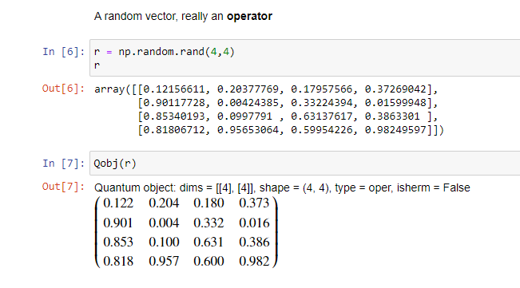
Operators: linear algebra’s function
Operators are (nxm) matrices that can operate on vectors (or other operators) – provided their dimensions match.
The example below creates a random operator – a 4 x 4 matrix consisting of all random values.

Slide 9
Operator example

Slide 10
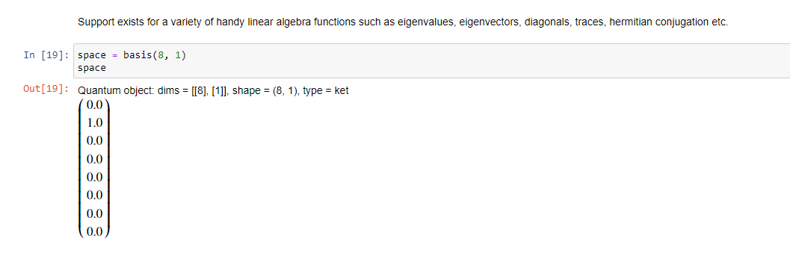
HILBERT SPACES
“The mathematical concept of a Hilbert space, named after David Hilbert, generalizes the notion of Euclidean space. It extends the methods of vector algebra and calculus from the two-dimensional Euclidean plane and three-dimensional space to spaces with any finite or infinite number of dimensions. A Hilbert space is an abstract vector space possessing the structure of an inner product that allows length and angle to be measured. Furthermore, Hilbert spaces are complete: there are enough limits in the space to allow the techniques of calculus to be used.” (https://en.wikipedia.org/wiki/Hilbert_space)
Creating a Hilbert space of arbitrary dimensions is trivial in QuTiP - in this case an 8-dimension space where the ground state energy is in the first state (n=1)

Slide 11
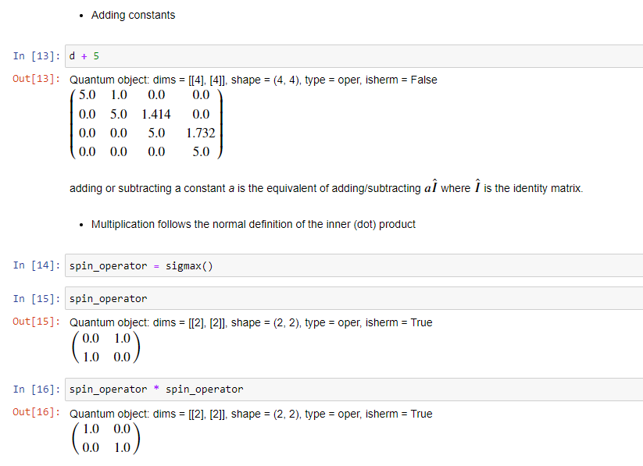
Matrix Mathematics

